Slide 1
Microservices + Events Putting the Chocolate in Your Peanut Butter Since 2018
Josh Lane
@jplane

Slide 2

Josh Lane
Independent consultant
20+ years as developer, architect, instructor, amateur psychiatrist
Finance, insurance, education, telecom, energy
Microsoft Azure MVP
@jplane
Twitter, GitHub, LinkedIn, GMail

Slide 3
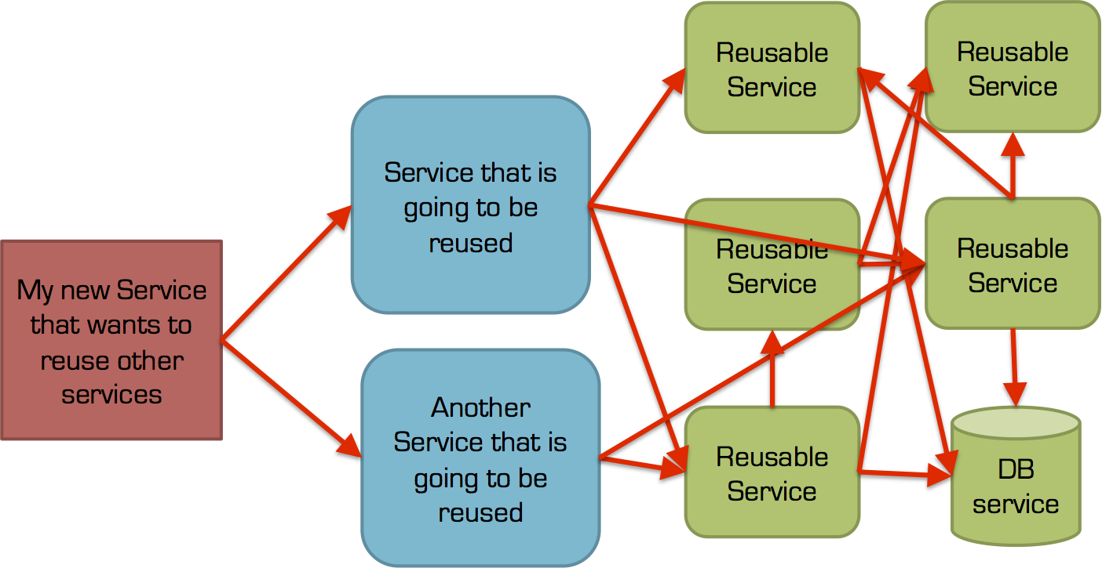

Slide 4

Cohesion vs. Coupling
Make Explicit Choices
We Need a Tool!

Slide 5
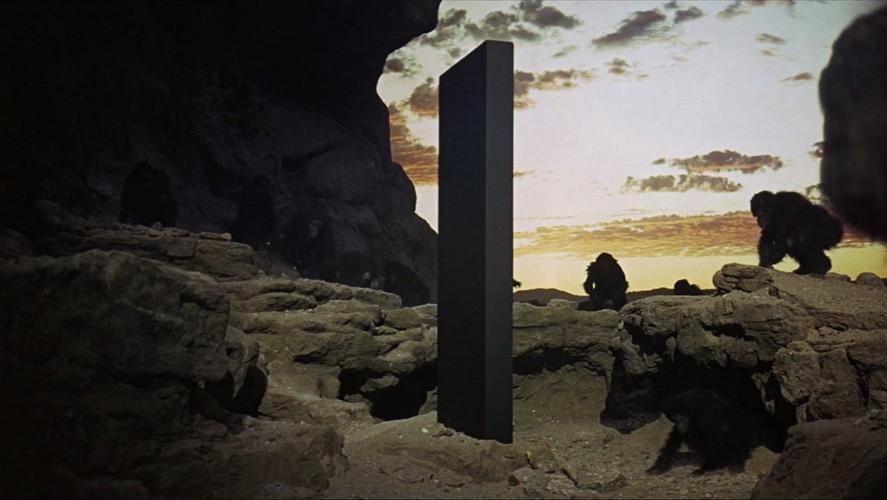
ACT I The Monolith

Slide 6



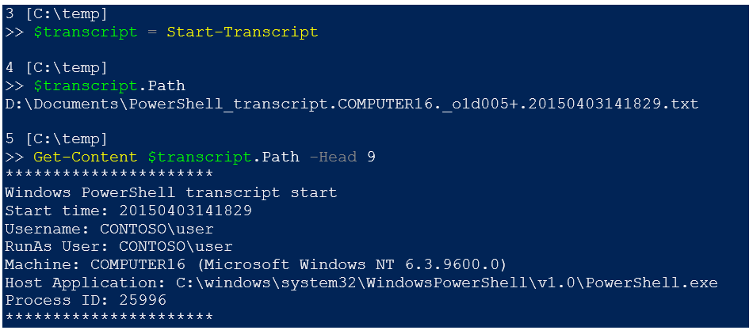
Web API
Inventory
Booking
Maintenance

Slide 7
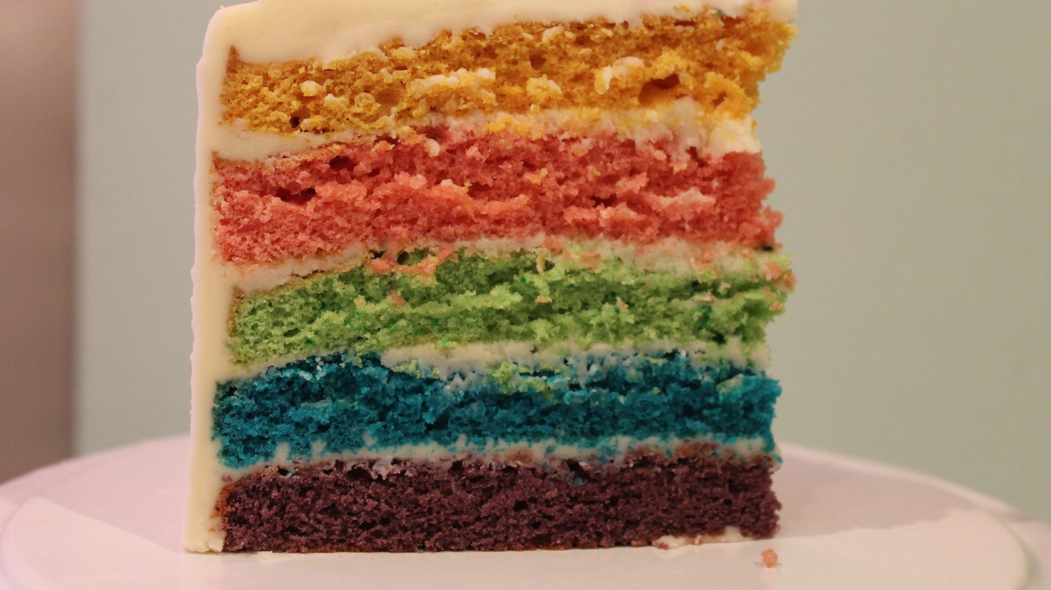
Monolith Architecture
Not inherently good or evil
Often low cohesion, high coupling
Coarse-grained deployment and versioning
Hard to evolve the tech stack
Hard to evolve the architecture
N-tier Layer Cake™

Slide 8
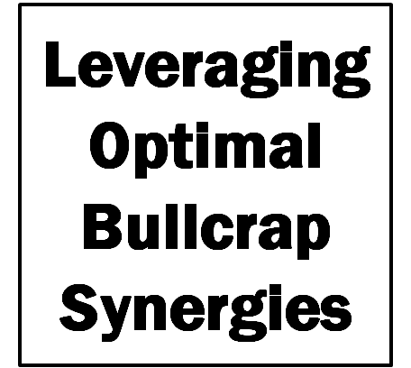
ACT II Minimum Viable Buzzword Compliance

Slide 9

External Inventory
API Facade
Internal Inventory
Booking
Maintenance

Slide 10
External Inventory
API Facade
Internal Inventory
Booking
Maintenance

Slide 11

Microservices Architecture
Not inherently good or evil
Easier to deploy, version, scale, secure, monitor independently*
Easier to evolve over time
Often high cohesion
Often hard to achieve low coupling, in practice

Slide 12

Let’s Be Independent, Together

Slide 13
Event Bus
External Inventory
API Facade
Internal Inventory
Booking
Maintenance

Slide 14
Microservices + Events
Not inherently good or evil
Easier to deploy, version, scale, secure, monitor independently
Easier to evolve over time
Often high cohesion
Often lower infrastructure coupling, in practice
Semantic coupling remains

Slide 15
Patterns
Domain events
Event correlation
Event aggregation
Eventual consistency
Lambda architecture
Event replay
What-if analysis

Slide 16


Slide 17
Thank you!

